Slide 1
Atopic Dermatitis: The Game

Slide 2
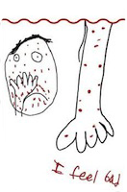
Who knows what Eczema is?
Atopic dermatitis (eczema) is a condition that makes your skin red and itchy.

Slide 3
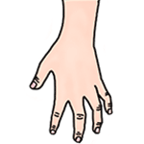



Eczema causes
Lots of itchiness. Luckily, we have tools to deal with it
Hello! I’m Emily the Emollient!
Nice to meet you!
Howdy friends! I’m Steve the Steroid!
I can’t wait to play!

Slide 4
What should you do if you feel itchy?
Do you scratch with a ruler?
Do you scratch very lightly?
Do you stop yourself from more scratching?
What should we do?

Slide 5
In fact
Scratching isn’t always bad
Sometimes it can be good as it helps decrease the itchiness
BUT
Too much scratching is bad because it can make the rash worse and cause it to spread/become infected
Notes:
Can you add pictures of a happy child for second line
Add a picture of a sad child for the 4th line

Slide 6
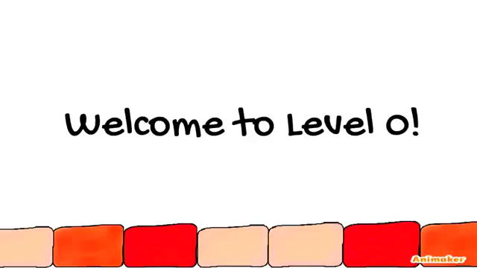
How to play Level 0
Notes:
Can you add the pics of each of the cells on the relevant lines and pics of left/right arrows

Slide 7
What to do when your skin becomes inflamed (red and itchy)
Steve the steroid only needs to be used once or twice a day for a few days or weeks at a time and should only be applied directly to the affected areas of skin.
What about when its normal?
Emily the Emollient can be applied everyday or as often as the bottle recommends. It should be used even if you feel the eczema has gone.

Slide 8

Emollient Maze

Slide 9
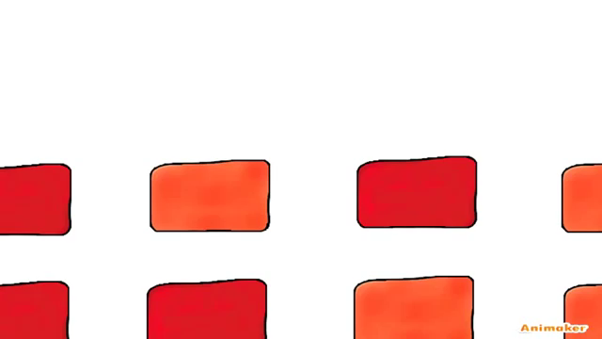
Steroid Maze

Slide 10

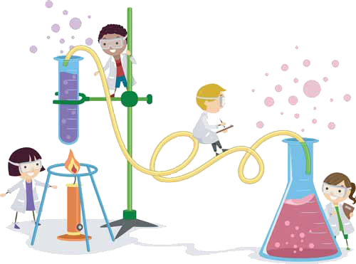
Now to learn the
behind eczema!

Slide 11
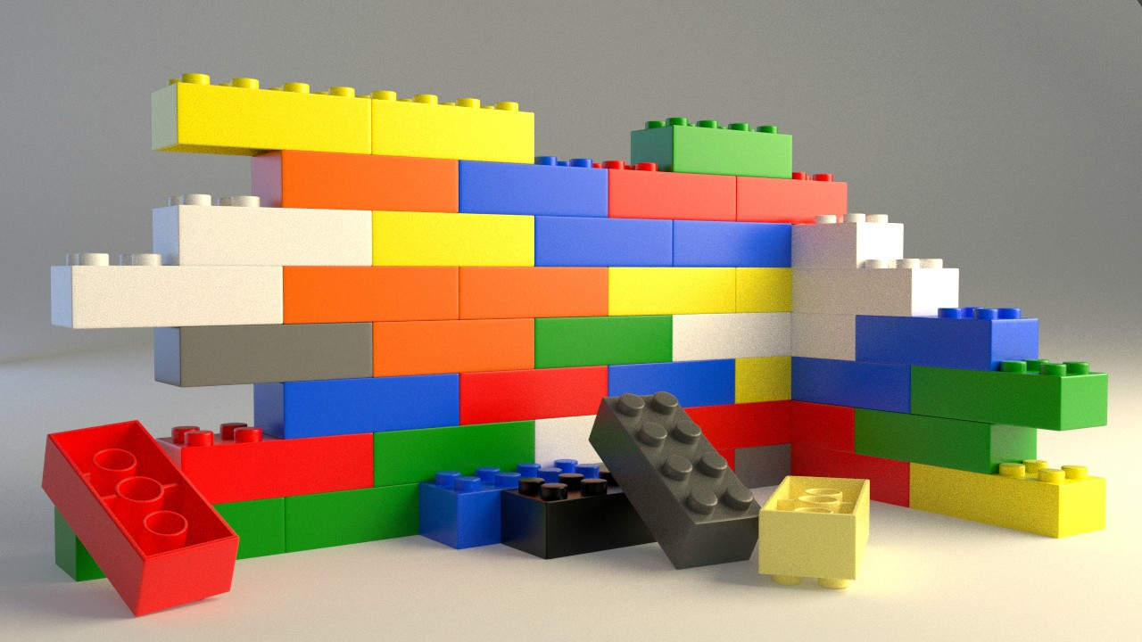
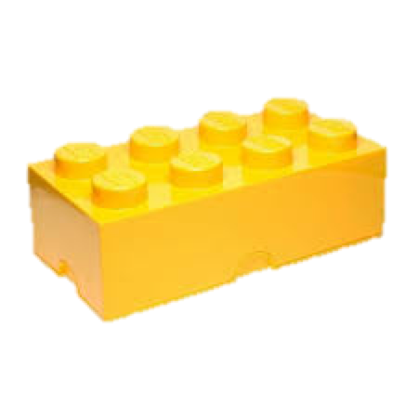
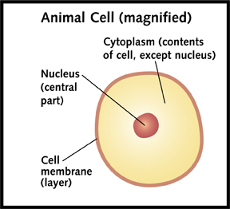
A cell
Imagine you are made of lego
One cell is basically each individual piece of lego
The are nearly, wait for it,
100 000 000 000 000
Cells in your body, that do all different things.

Slide 12










The actors involved
Kirk the KLK-5
Desmond the Corneodesmosomes
Like a rope that holds the skin cells together,
INFLAMMATION!
Perry the PAR2
activated when hit by KLK 5 hits it
increased production of KLK 5 and LEKTI
Lucas the LEKTI

Slide 13
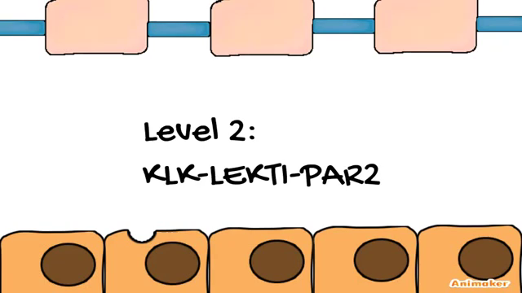
KLK-LEKTI Level
Notes:
I just found out that ks2 don’t even know about cells or proteins.

Slide 14
Enzymes
Enzymes speed up chemical reaction – KLK-LEKTI
Lock and Key concept
https://www.youtube.com/watch?v=i6HflIPr7_g
One of the things that effect enzyme activity is pH
In our game, high pH→more activity of KLK
Notes:
An enzyme is something that speeds up a chemical reaction – like when coke makes you run really really fast

Slide 15

pH
Acidic
pH is measured on a scale of 0 to 14
Basic
Sour
Very low pH
Think of something that you see every day that is acidic?
Bitter
Very high pH
Think of something you see every day that is basic?
Notes:
pH is a measurement of how acidic-basic a chemical is.
For example, think of the taste
of a lemon! That’s very acidic (very
Low pH)
While soap is very bitter,
slippery and hence, basic (very
High pH)

Slide 16
Healthy Skin has a pH of 4.5
Notes:
If pH exceeds this value, LEKTI’s enzymatic activity decreases making active KLK increase in number
When active KLK increases in number, more desmosomes are broken down, causing itchiness

Slide 17
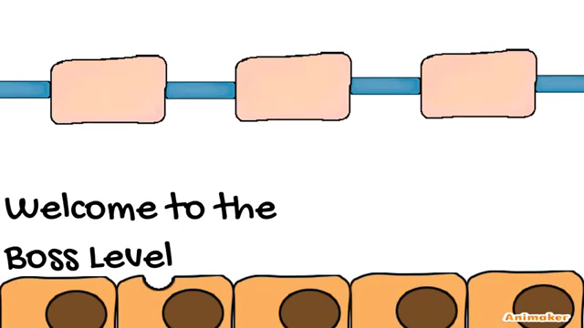
Boss Level

